Slide 1
Inventory Management System
Group - 6

Slide 2
Team Members Project Lead: Sayed Saud Ali
Back End: | Employee Id: | Front End: | Employee Id: | Junit testing: | Employee Id:
Sayed Saud Ali | 2492004 | S Shiva Kumar | 2492230 | Saurabh Sudhir Shinde | 2488492
Saurabh Rajendra shinde | 2492157 | Sameena Banu | 2492249 | Sayandip Bidyut Guha | 2492110
Rutuja Ramhari Borate | 2492631 | Shaik Mohammad Sharuk | 2492309 | ------------------ | ------------------
Rushadarka Chakraborty | 2492613 | Sanketa x | 2491673 | ------------------- | ------------------

Slide 3
INDEX
Introduction
Project Scope
Class diagram
Tools and Technologies
Data Flow Diagrams
Use Case Diagram
ER Diagram
Tasks Performed
Output ScreenShots
Conclusion

Slide 4
Introduction:
A business can run its operating activities smoothly only when appropriate amount of inventory is maintained.
Inventory affects all operating activities like manufacturing, warehousing, sales etc.
The amount of opening inventory and closing inventory should be sufficient enough so that the other business activities are not adversely affected. Thus, inventory plays an important role in operations management.

Slide 5
Project Objective:
To create a dynamic and responsive Java full stack web application for Inventory Management System for selling and buying product.

Slide 6
Project Scope
The value of the inventory at the end of each period provides a basis for financial reporting on the balance sheet. Measuring the change in inventory allows the company to determine the cost of inventory sold during the period. This allows the company to plan for future inventory needs.

Slide 7
Software Requirements:
Language Requirement :Java(Backend).
Frond-End : html, CSS, bootstrap, jQuery and Angular
Web server :Tomcat Server
Database : MY SQL Workbench
Tool : Eclipse ,Visual Studio Code and Postman.

Slide 8
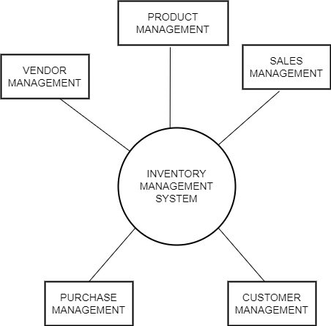
Data Flow Diagram:

Slide 9
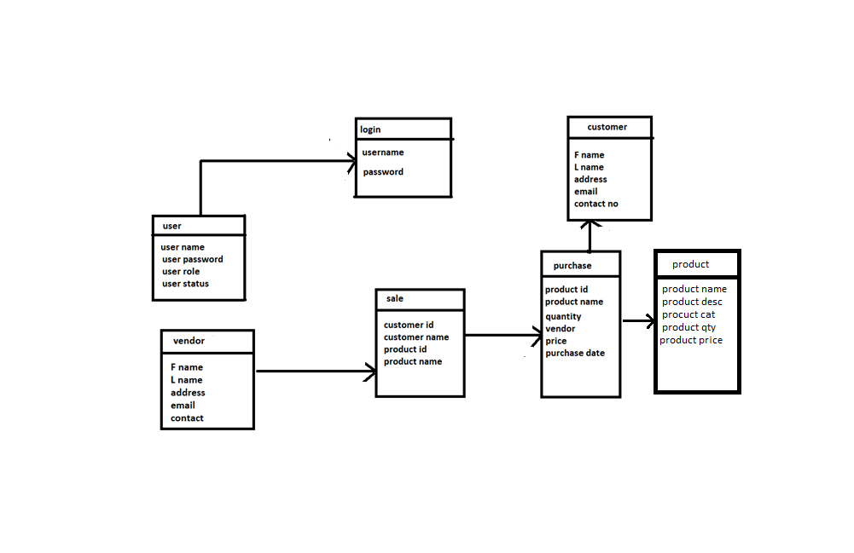
Class Diagram

Slide 10
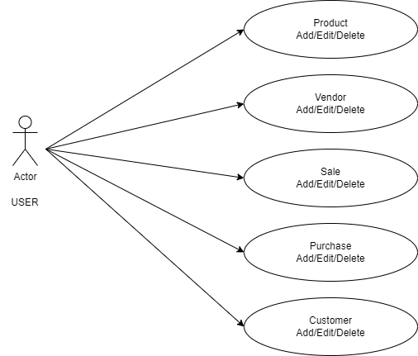
Use Case Diagram

Slide 11
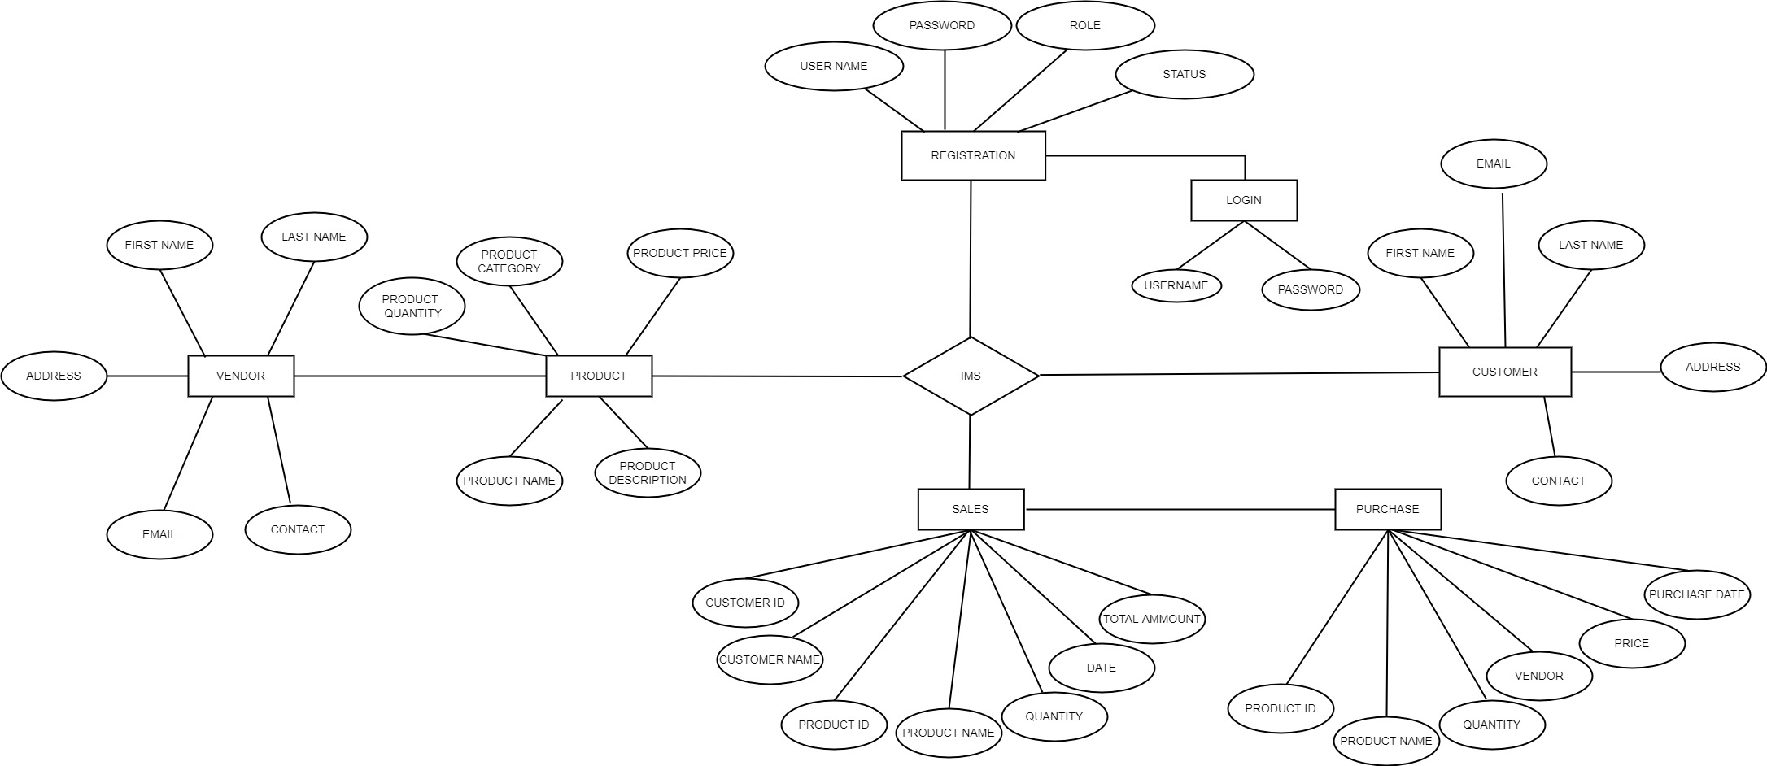
ER Diagram

Slide 12
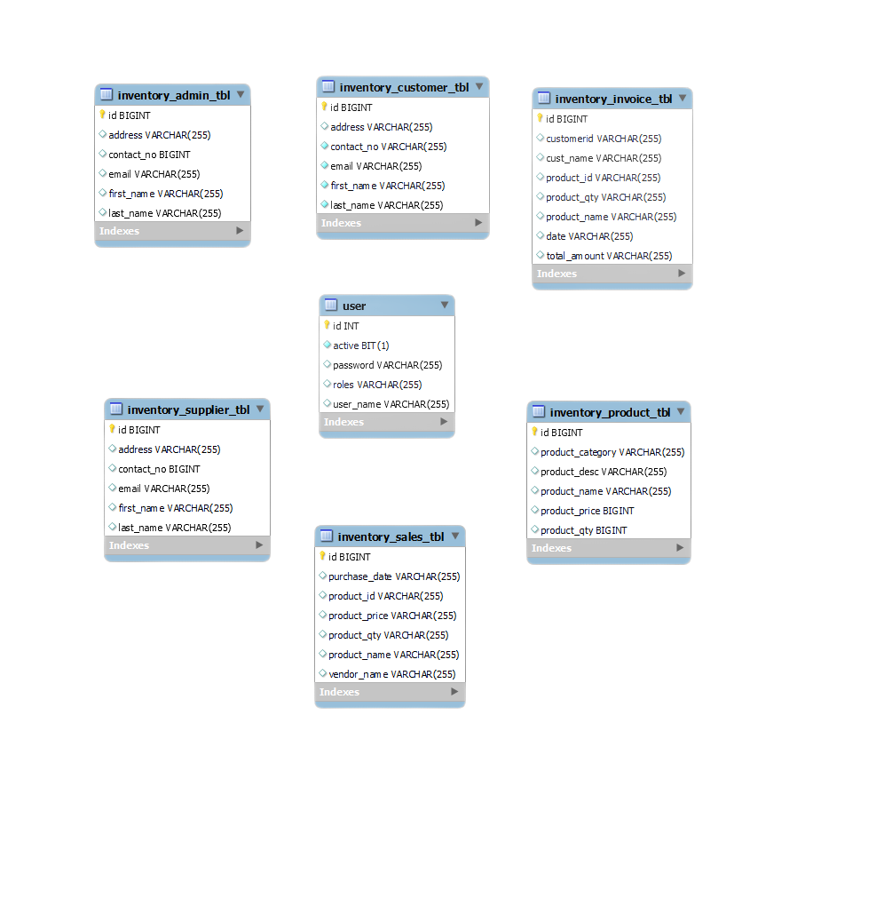
Database Schema

Slide 13
Tasks Performed by User
User logins to the system and manage all the functionalities of Inventory Management System
User can add, edit, delete and view the records of Inventory, Purchasing, Payment, Login
User can manage all the details of Customer, Receiving Stock, Supplier
User can also generate reports of Inventory, Customer, Purchasing, Receiving Stock, Payment, Supplier
User can search the details of Customer, Payment, Supplier
User can apply different level of filters on report of Inventory, Receiving Stock, Payment
User can tracks the detailed information of Customer, Purchasing, Receiving Stock,Payment.

Slide 14
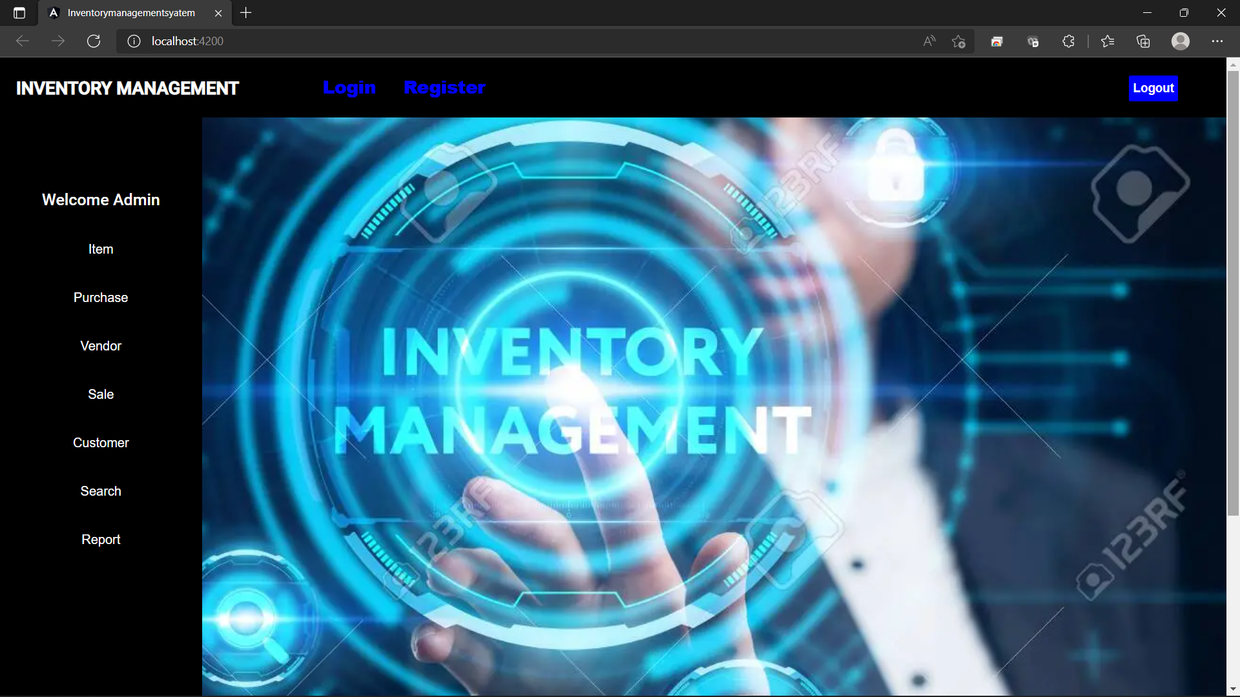
Project Dashborad

Slide 15
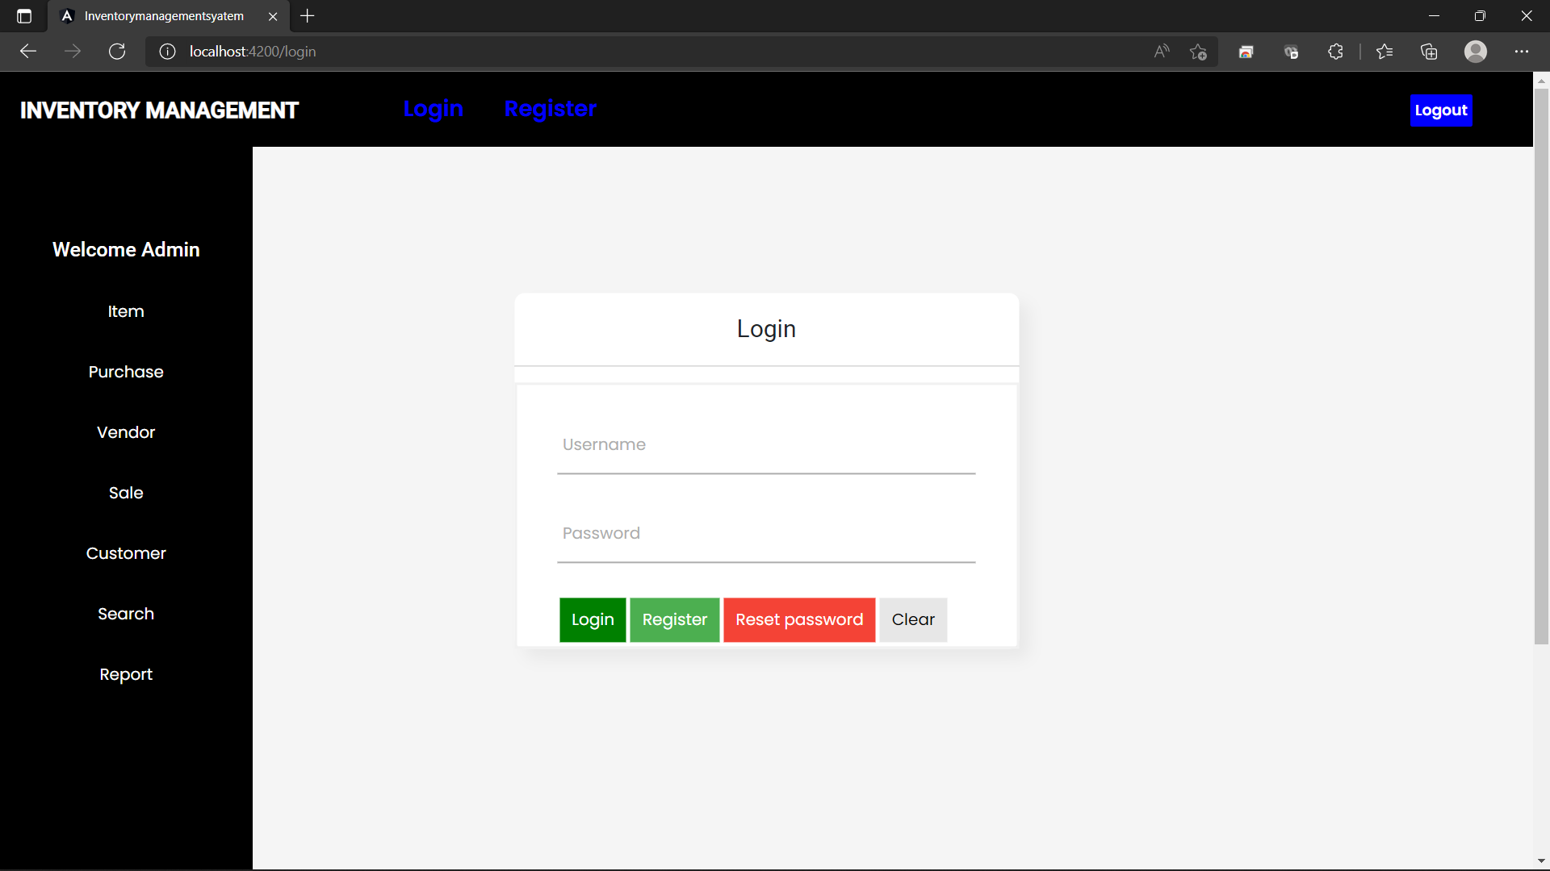
LOGIN PAGE

Slide 16
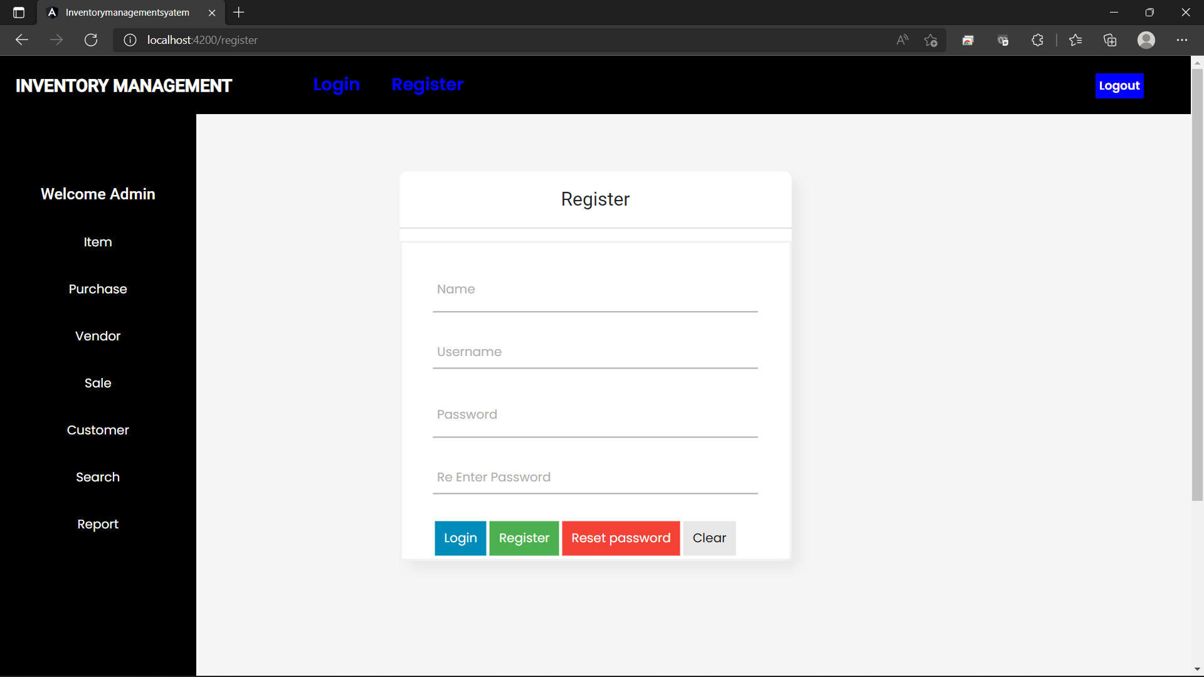
Register Page

Slide 17
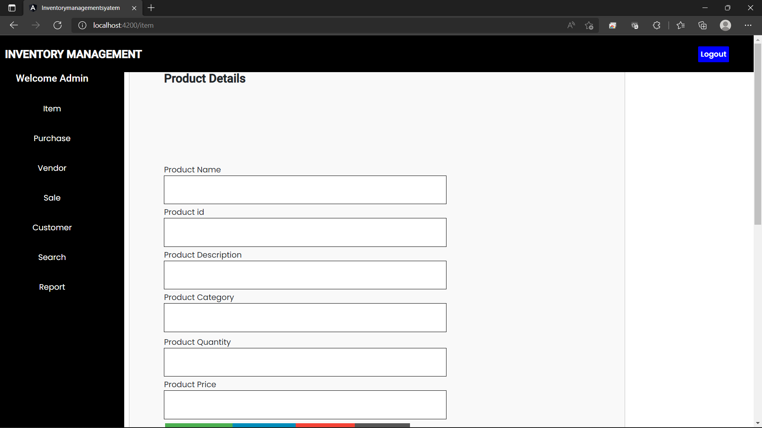
Item Page

Slide 18
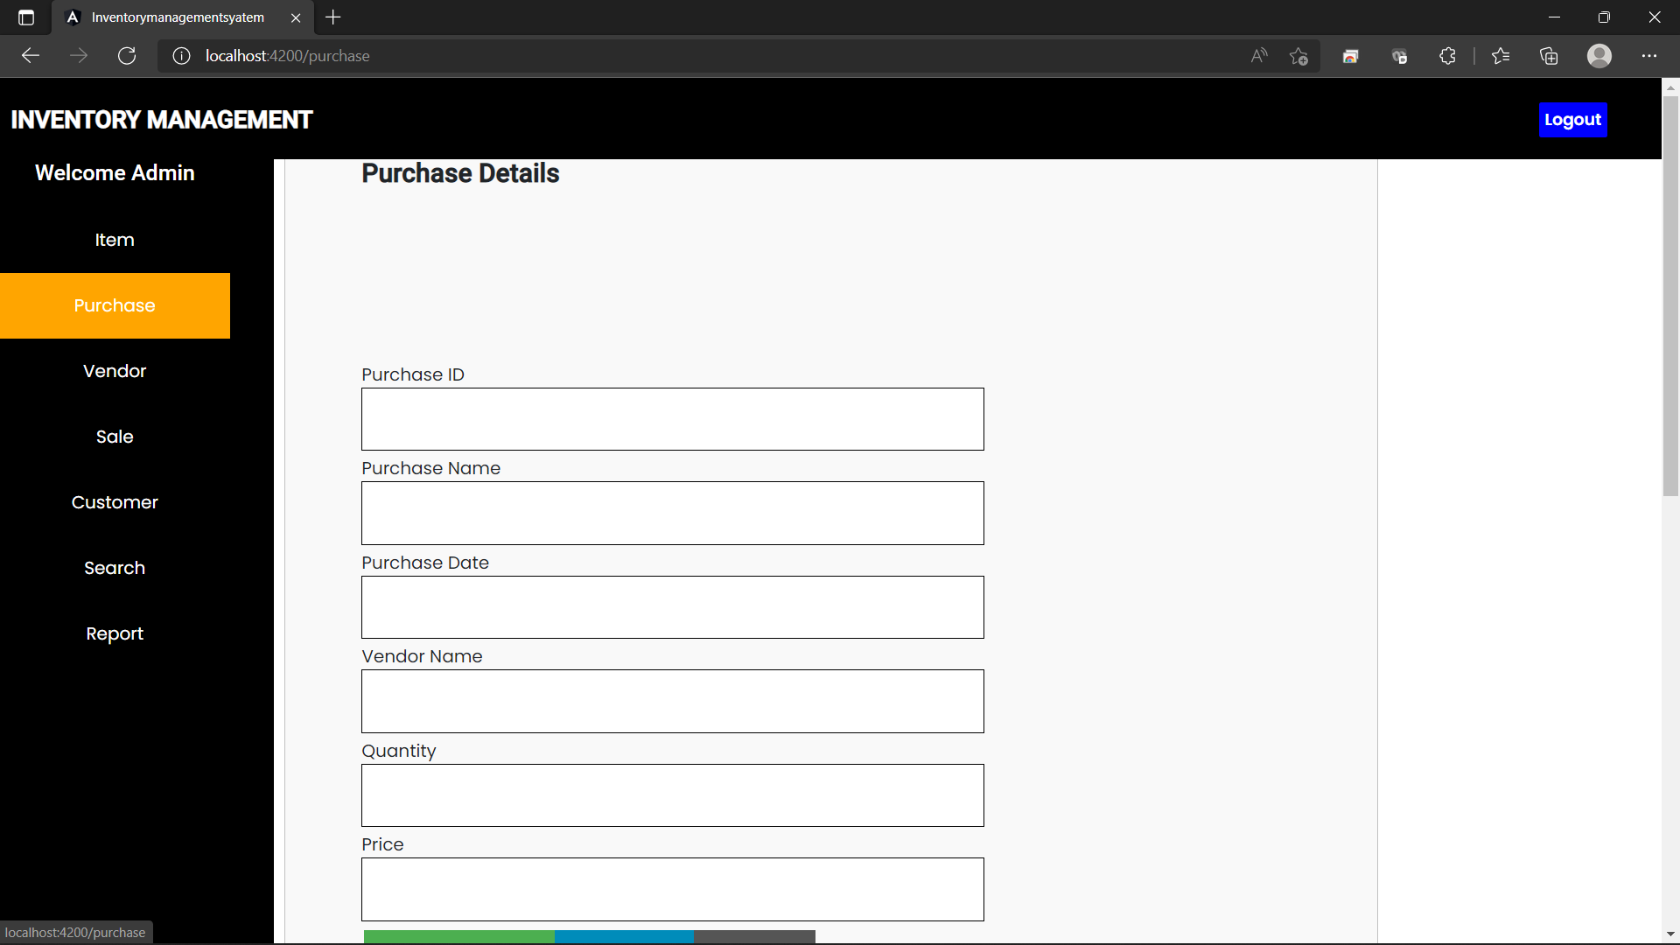
Purchase Page

Slide 19
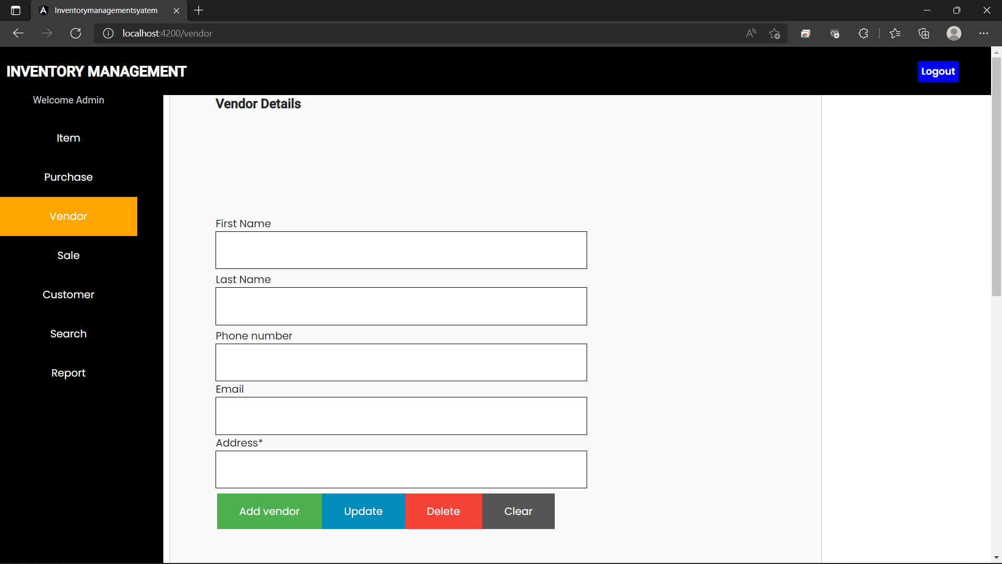
Vendor Page

Slide 20
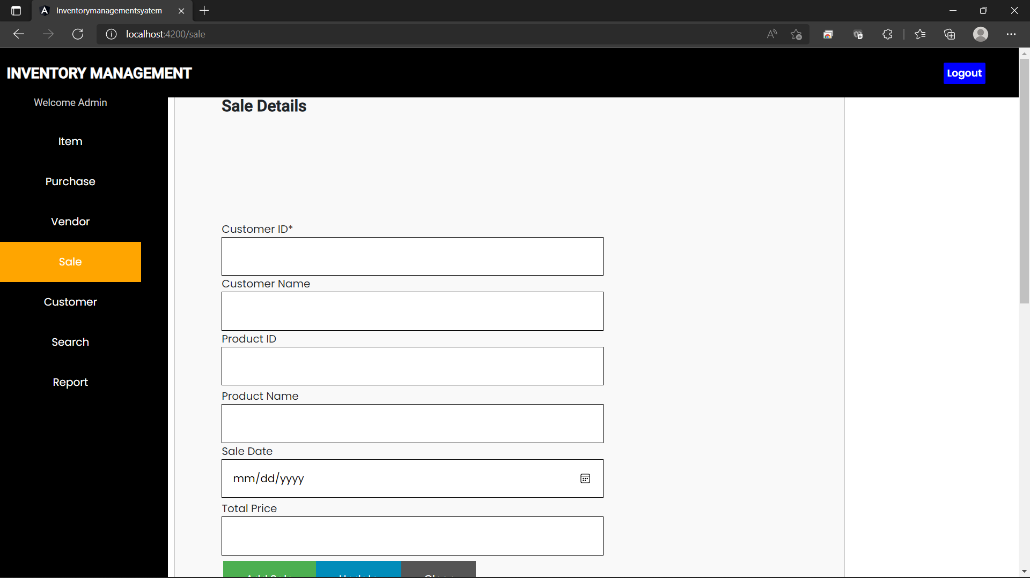
Sales Page

Slide 21
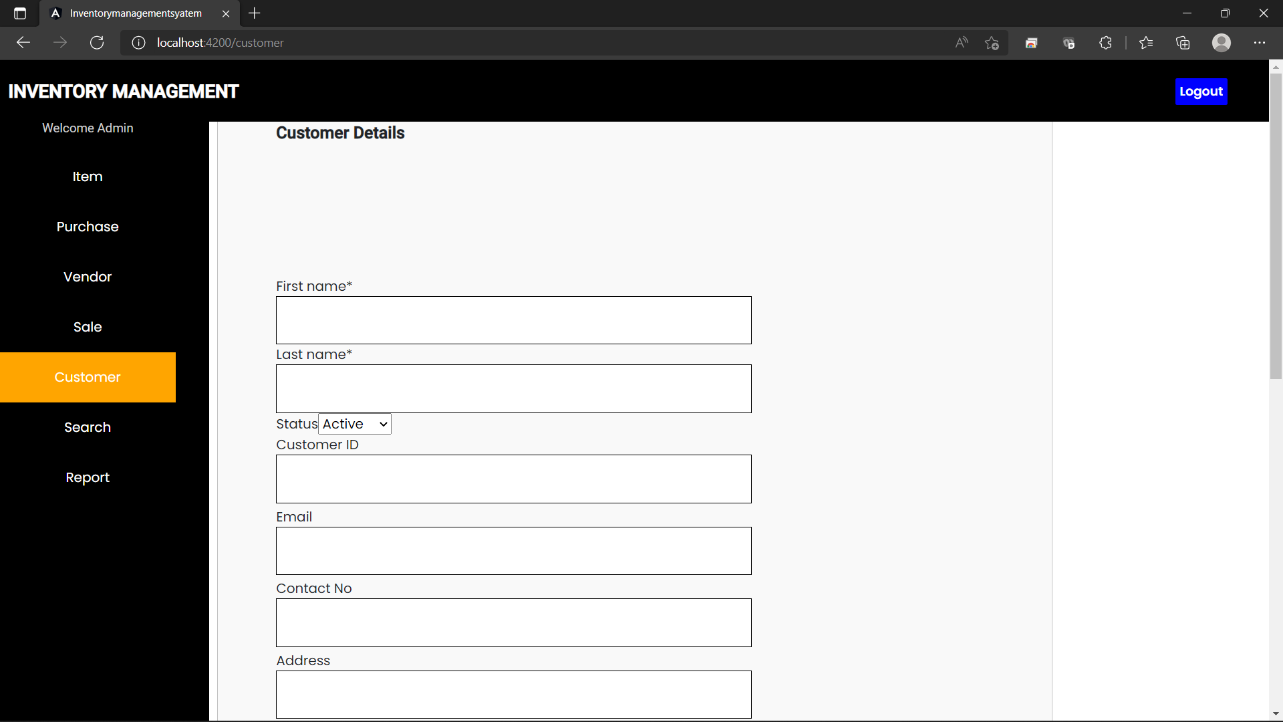
Customer Page

Slide 22
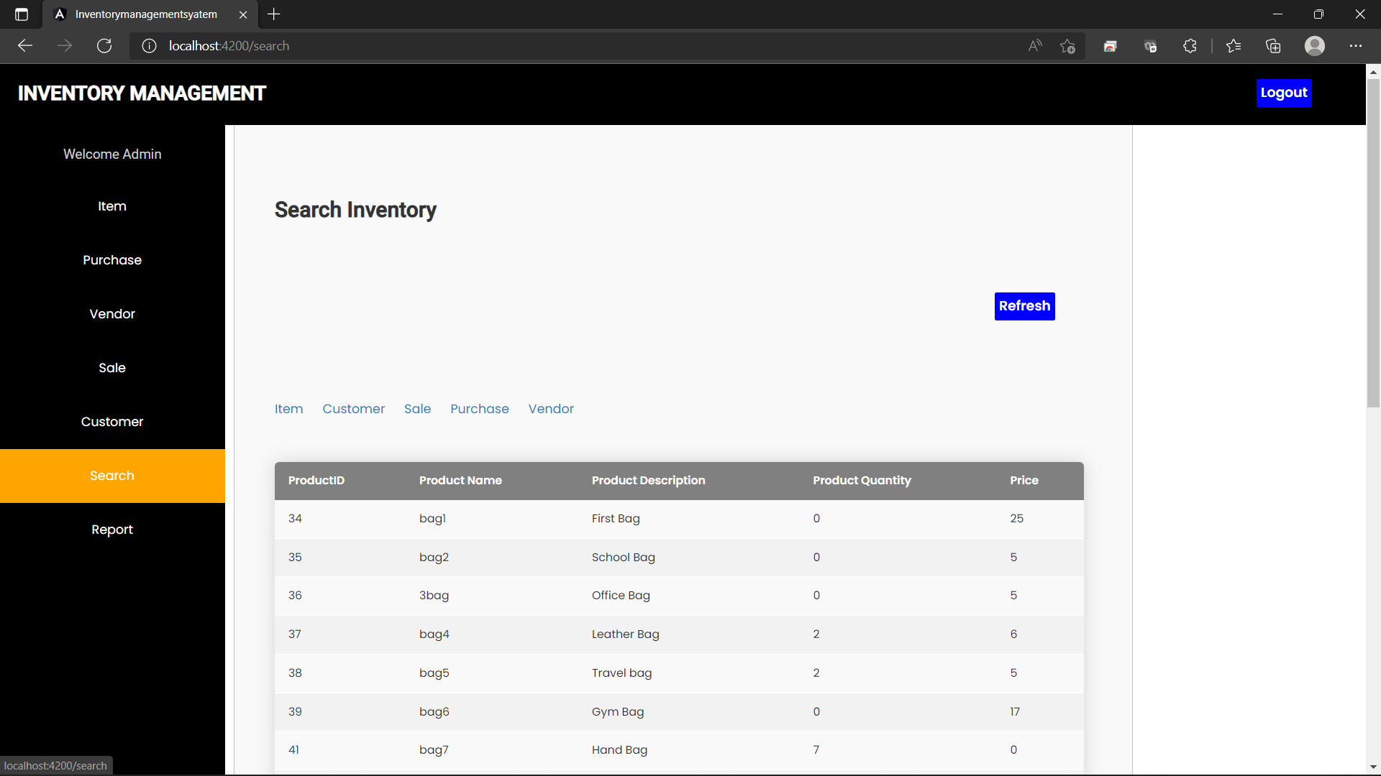
Search Page

Slide 23
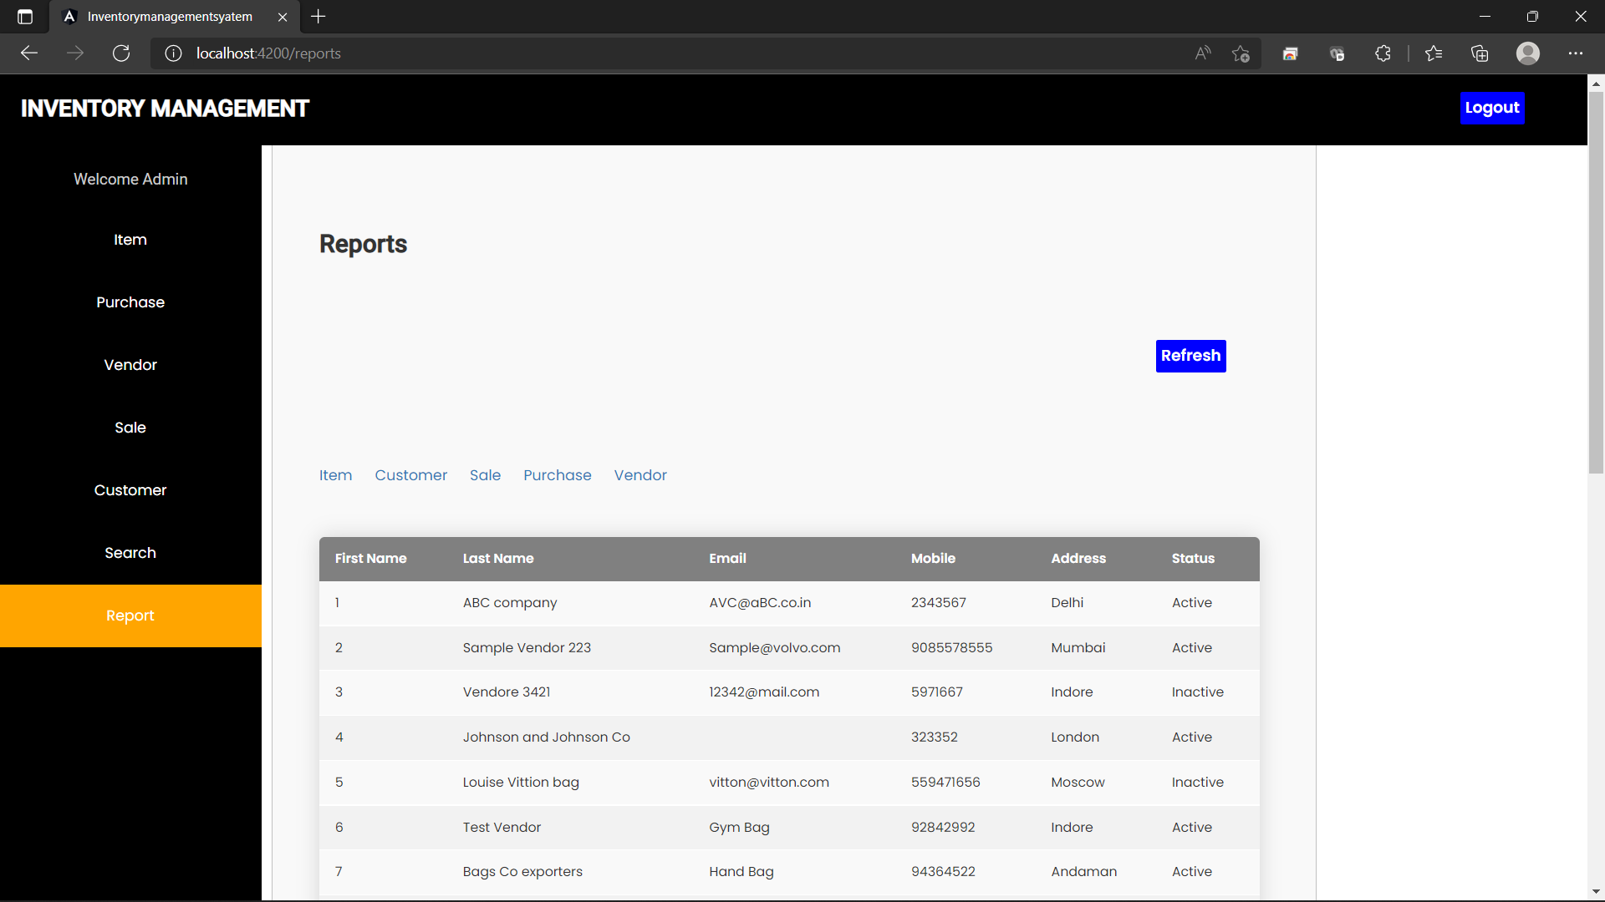
Reports Page

Slide 24
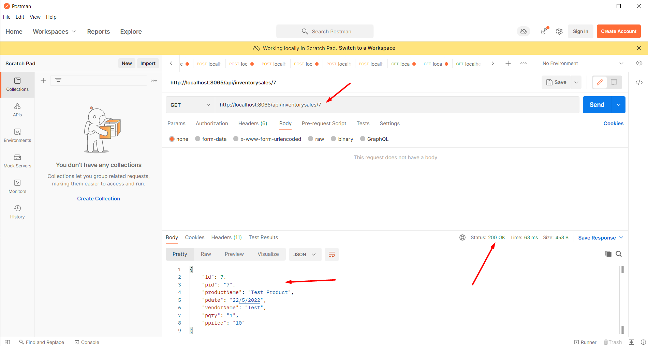
REST API’s Testing GET METHOD

Slide 25
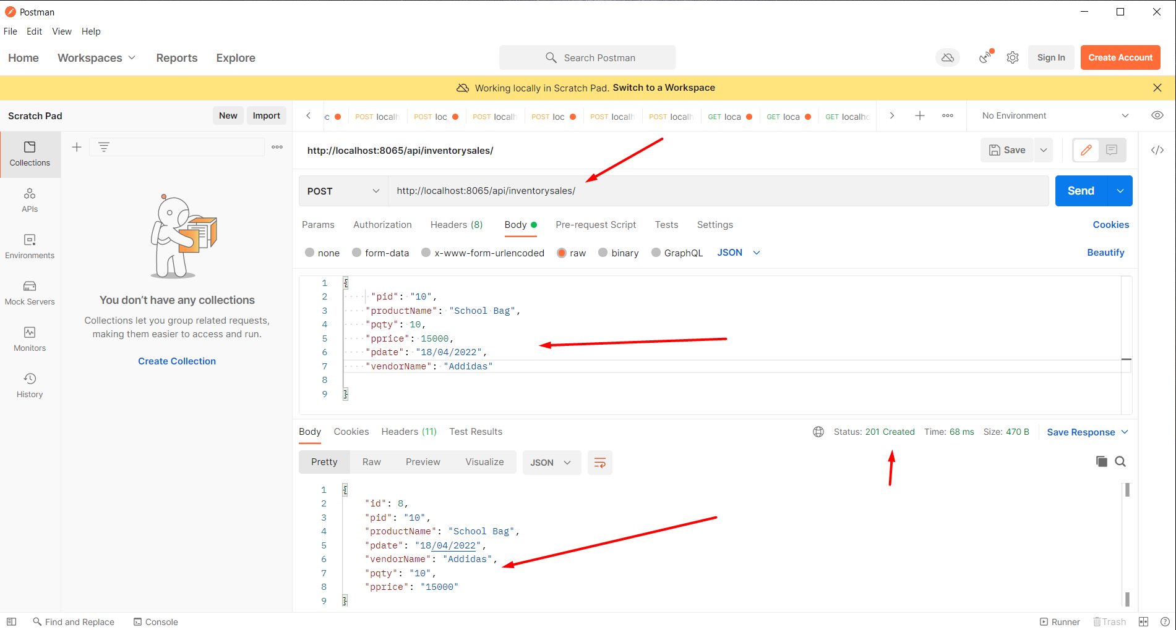
REST API’s Testing POST METHOD

Slide 26
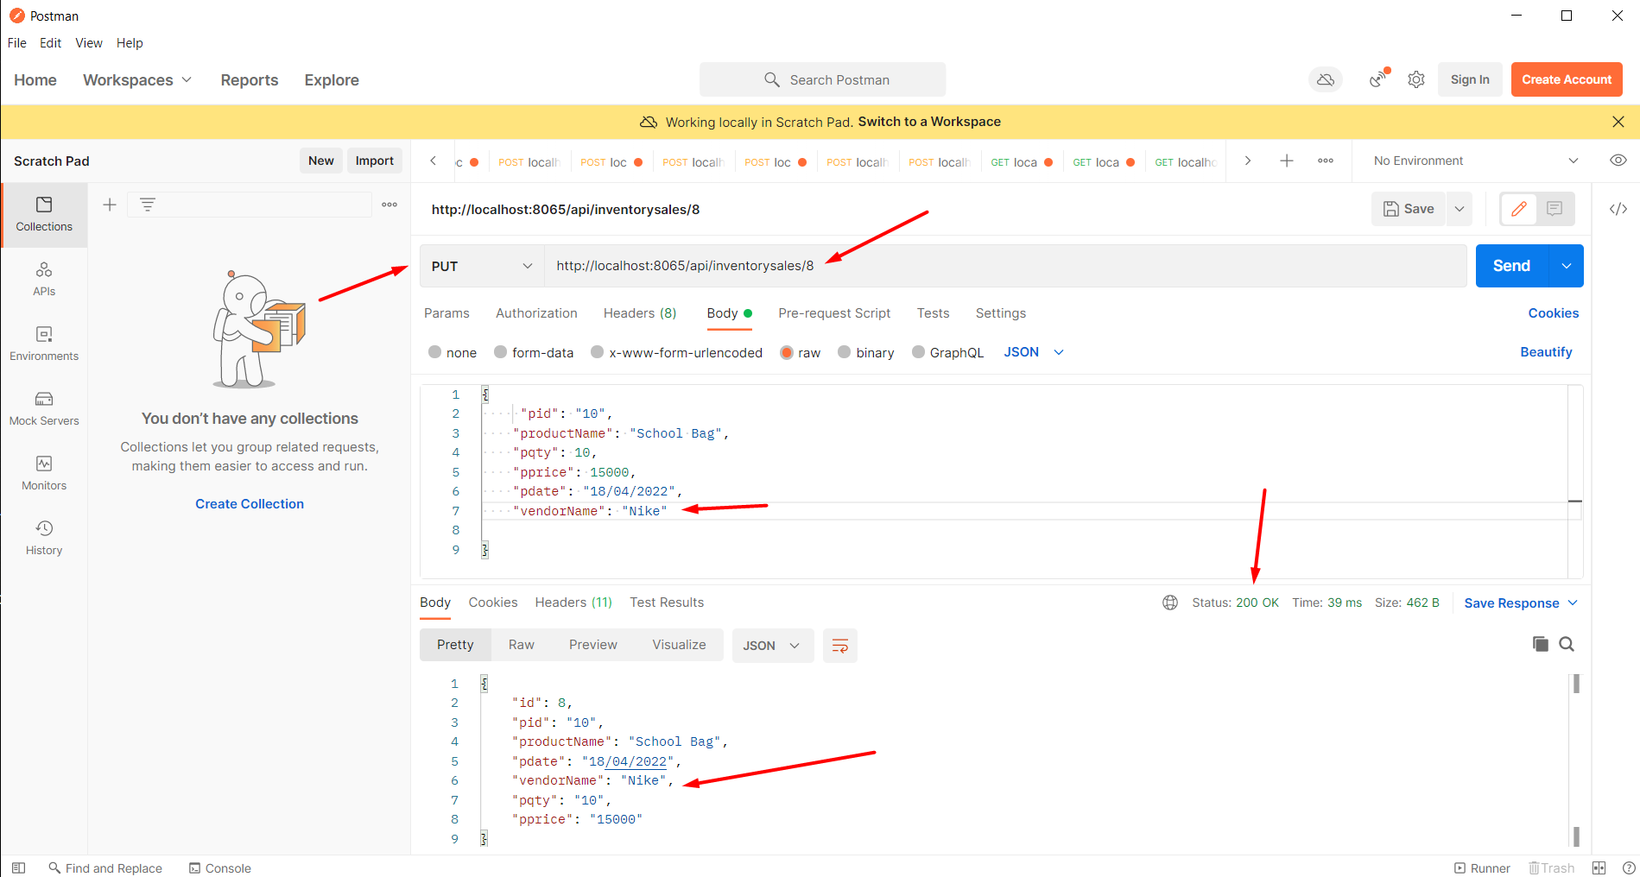
REST API’s Testing PUT METHOD

Slide 27
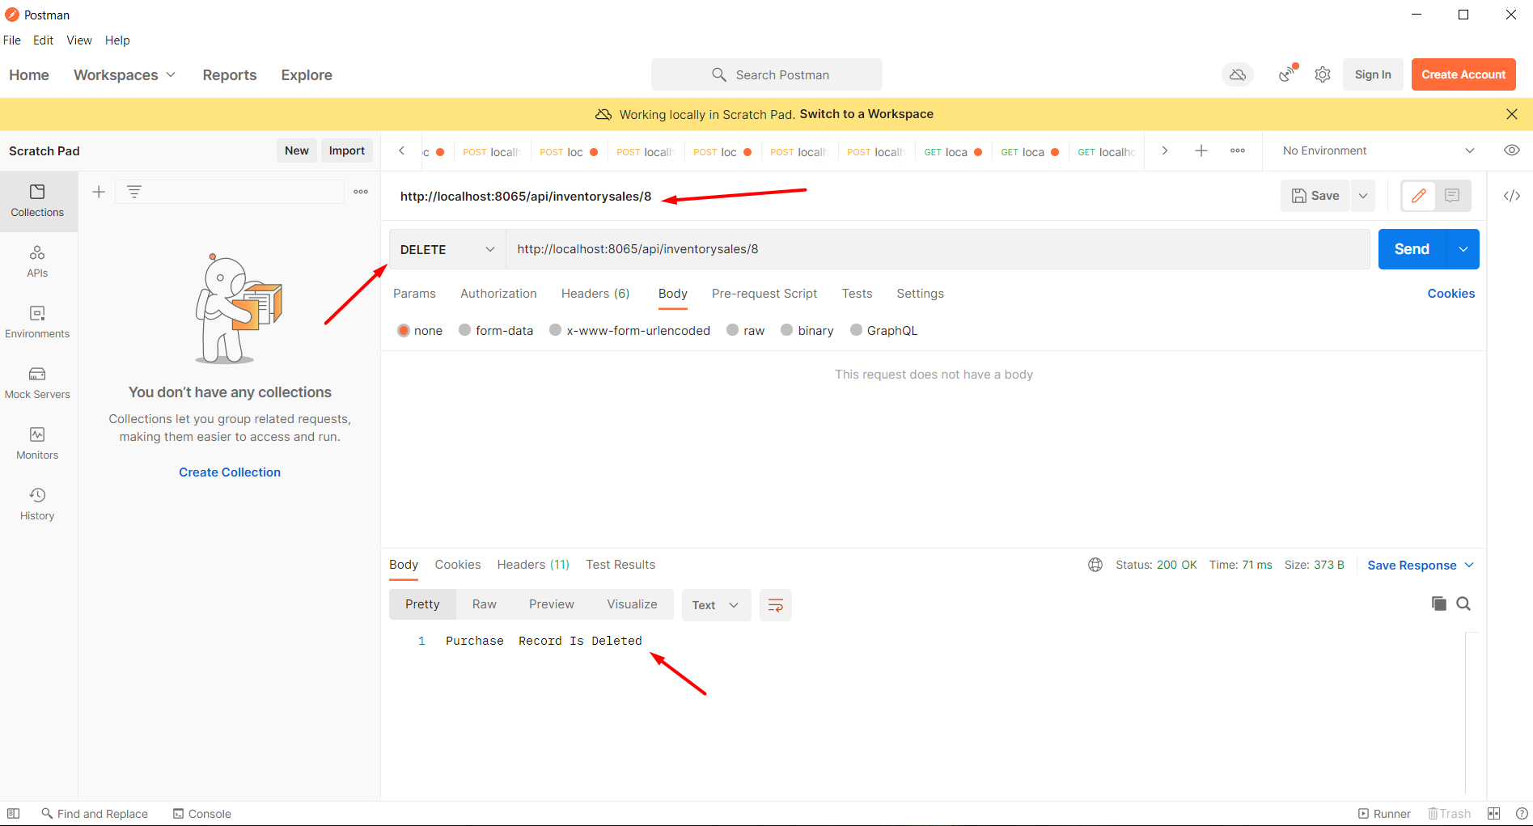
REST API’s Testing DELETE METHOD

Slide 28
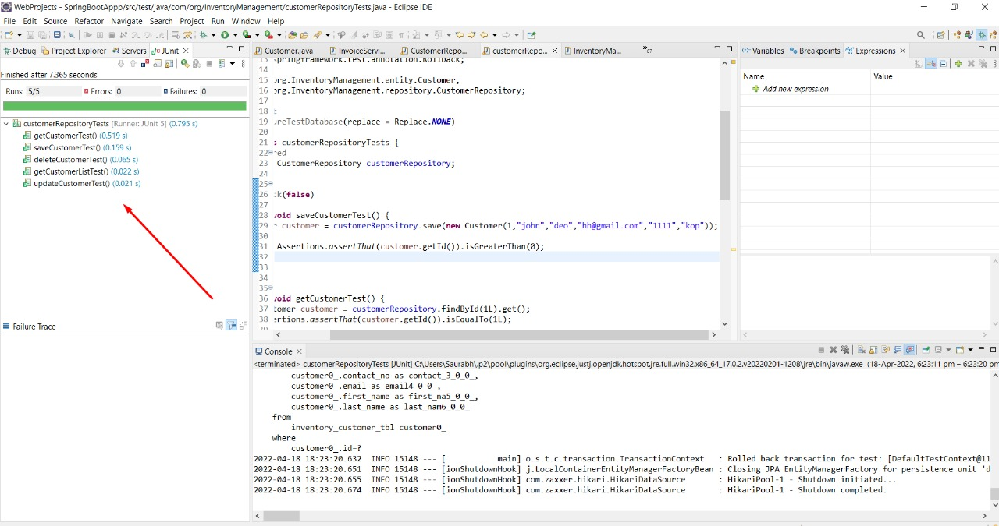
JUNIT Testing FOR CUSTOMER MODULE

Slide 29
PROJECT BENEFITS
Benefits of effective inventory management At the most basic level, after all, your job is to supply the products to meet consumer demand. You can’t do that without effective inventory management

Slide 30
Conclusion
Inventory management has to do with keeping accurate records of goods that are ready for shipment.
Accurately maintaining figures on the finished goods inventory makes it possible to quickly convey information to sales personnel as to what is available and ready for shipment at any given time by buyer.
Highly trained Inventory management and high-quality software will help make Inventory management a success.
Supply and demand is a delicate balance, and inventory management hopes to ensure that the balance is undisturbed.

Slide 31
THANK YOU….

